Slide 1
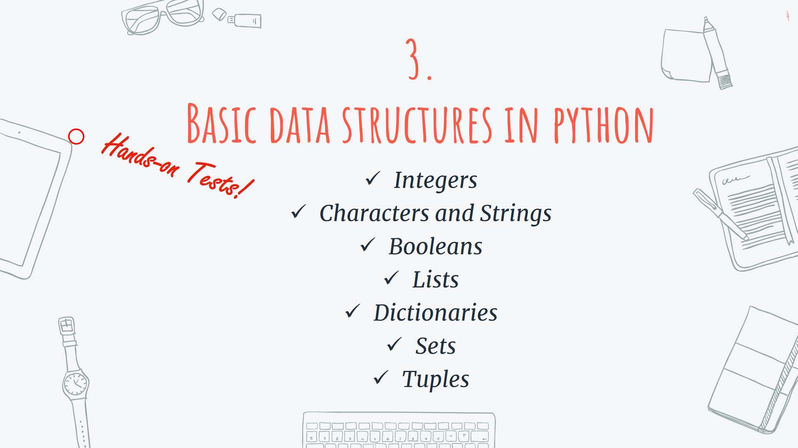

Slide 2
Contents
1
Numbers, Strings and Booleans
2
Lists
Dictionaries
Sets
Tuples
Integers (int) – Floating Point(float) – Strings(str) – Booleans(bool)
And variable assignments
List (list): Ordered Sequence of Objects – [1, “Hey” , [2,3]]
3
Dictionaries(dict): Unordered Key-Value Pairs – {“Key” : “Value” , “Age” : 23}
4
Sets(set): Unordered Unique Objects – {“1” , 1 , 2 , “a”}
5
Tuples(tup): Ordered Immutable Sequence of Objects – (1 , “Hey” , [2,3])

Slide 3
Numbers in Python
We work with two main number types:
Integers(int): 1, 3 , 121 , …
Floating point numbers(float): 1.2 , 0.1 , 101.0
Let’s try some simple math in python!

Slide 4
But what do these numbers represent? How can we save them or assign them?

Slide 5
Variable Assignments
We can assign values to variables in python:
My_weight = 75.3
My_height = 170 + 4
Type()
Let’s see some examples in the code!

Slide 6
Some Rules for Variable Names…
There mustn’t be any spaces in names:
Names must not start with numbers:
Names must not contain any of these symbols:
Avoid using reserved names in python :
You will learn reserved names during the course. Don’t worry about it!
× My Age = 22
My_Age = 22
× 2Age = 22
Age2 = 22
“ , : <> / ? | \ * - + () ~ ! @ # $ % ^ &
× for = 22
× if = 22
× int = 22

Slide 7
Try to use the same naming format during all parts of your program.
Some Clean Code Tips…

Slide 8

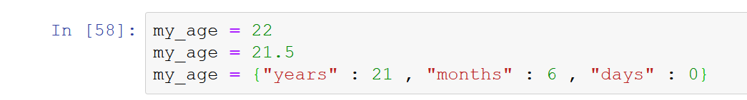
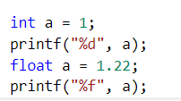
Dynamic Typing in Python
Python is a Dynamic-Typed language,
It means, it’s possible to reassign same variables to different types of data:
Some languages like C, C++ are Static-Typed

Slide 9
Try not to use the same variable names for different types of data.
Some Clean Code Tips…
Even in Python!

Slide 10
Strings
Strings are sequence of characters,
Both “ and ‘ are acceptable
My_name = ‘Kaveh’
My_family_name = “Masoumi”
My_course_name = “Programming with python”

Slide 11
Indexing Strings
With the notation variable_name[ index ], we can access to the characters
My_name = “Kaveh”
My_name[2]
Index starts with 0 and continues till n – 1 and also from –(n-1) to 0
Character | ‘K’ | ‘a’ | ‘v’ | ‘e’ | ‘h’
Index Positive | 0 | 1 | 2 | 3 | 4
Index Negative | -5 | -4 | -3 | -2 | -1

Slide 12



Slicing Strings
You can also grab a slice of a string
Variable_name[Start : Stop : Step]
My_name[0:3:2] → “Kv”
Strings have helpful methods such as .split() , .find() and etc.
Also remember : String are immutable
Start: $Starting index$
Stop: $Ending index −1$
Step: $Size of every jump$

Slide 13
Now let’s get back to the code…

Slide 14
Contents
1
Numbers, Strings and Booleans
2
Lists
Dictionaries
Sets
Tuples
Integers (int) – Floating Point(float) – Strings(str) – Booleans(bool)
And variable assignments
List (list): Ordered Sequence of Objects – [1, “Hey” , [2,3]]
3
Dictionaries(dict): Unordered Key-Value Pairs – {“Key” : “Value” , “Age” : 23}
4
Sets(set): Unordered Unique Objects – {“1” , 1 , 2 , “a”}
5
Tuples(tup): Ordered Immutable Sequence of Objects – (1 , “Hey” , [2,3])

Slide 15
Lists
Ordered sequence of objects :
Mylist = [1 , True , “Hey” , 2.1 , [1,2,3]]
Use the same indexing and slicing notation as Strings
Some useful methods such as .append() , .pop() , .sort() …
Let’s get back to the code…

Slide 16
Contents
1
Numbers, Strings and Booleans
2
Lists
Dictionaries
Sets
Tuples
Integers (int) – Floating Point(float) – Strings(str) – Booleans(bool)
And variable assignments
List (list): Ordered Sequence of Objects – [1, “Hey” , [2,3]]
3
Dictionaries(dict): Unordered Key-Value Pairs – {“Key” : “Value” , “Age” : 23}
4
Sets(set): Unordered Unique Objects – {“1” , 1 , 2 , “a”}
5
Tuples(tup): Ordered Immutable Sequence of Objects – (1 , “Hey” , [2,3])

Slide 17
Dictionaries
Use the notation { }
Unordered sequence of key-value objects (no sorting)
Dictionaries are like lists but they don’t use indexes
Dictionaries use key-value mapping
My_dictionary = {“key1” : “value1” , “key2” : 2 , 5 : 7 , “list” : [1,2,3]}
My_dictionary [“key1”] → value1
My_dictionary[5] → 7
Some useful methods like .values() , .keys() , .items() and etc.
Time to see the concepts in code…

Slide 18
Contents
1
Numbers, Strings and Booleans
2
Lists
Dictionaries
Sets
Tuples
Integers (int) – Floating Point(float) – Strings(str) – Booleans(bool)
And variable assignments
List (list): Ordered Sequence of Objects – [1, “Hey” , [2,3]]
3
Dictionaries(dict): Unordered Key-Value Pairs – {“Key” : “Value” , “Age” : 23}
4
Sets(set): Unordered Unique Objects – {“1” , 1 , 2 , “a”}
5
Tuples(tup): Ordered Immutable Sequence of Objects – (1 , “Hey” , [2,3])

Slide 19
Sets
Unordered Unique Objects
Myset = set()
Useful methods like add() , remove() , pop() , copy() …
Could be used to eliminate repetitive elements in list
Mylist = [1,1,1,1,1,1,1,2,3,3,3,3]
Myset = set(Mylist)
Myset → (1 , 2 , 3)
Now let’s try some examples in practice…

Slide 20
Contents
1
Numbers, Strings and Booleans
2
Lists
Dictionaries
Sets
Tuples
Integers (int) – Floating Point(float) – Strings(str) – Booleans(bool)
And variable assignments
List (list): Ordered Sequence of Objects – [1, “Hey” , [2,3]]
3
Dictionaries(dict): Unordered Key-Value Pairs – {“Key” : “Value” , “Age” : 23}
4
Sets(set): Unordered Unique Objects – {“1” , 1 , 2 , “a”}
5
Tuples(tup): Ordered Immutable Sequence of Objects – (1 , “Hey” , [2,3])

Slide 21
Tuples
Tuples are like lists → Ordered sequence of objects
But Tuples are immutable → A good question, why immutability?
Useful methods such as count() and index()
The notation to use tuples is ()
My_Tuple = (1 , 1 , “Hey” , True)
Let’s get back to code…

Slide 22

Thanks!
Got any questions or suggestions?
Here’s some contact info:
@KMasoumi

